Slide 1
DEEP LEARNING CNN
SUPERVISED CLASSIFICATION TASK

Slide 2
PNEUMONIA X-RAY DATASET
Dataset of 5863 X-Ray images from KAGGLE.COM
Imbalanced dataset, limited amount of data for training
Training, validation, test data in separate folders
Task is to predict pneumonia from an X-Ray image
Compare different CNN models, choose the best one

Slide 3
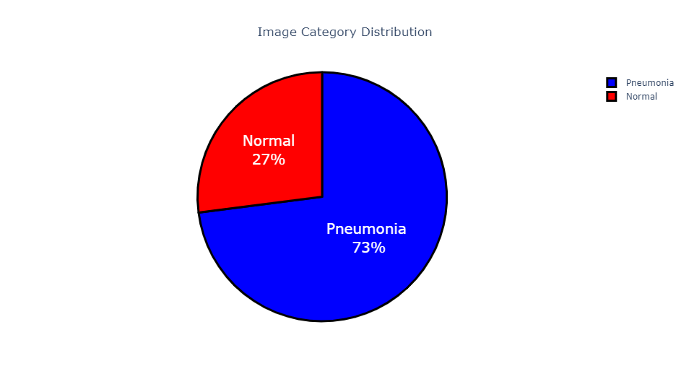
DATA CLEANING AND FEATURE ENGINEERING PHASE
imbalanced data
27% normal, 73% pneumonia
Total pneumonia: 4273
Total normal: 1583
Only 16 images in validation folder
Disregard validation images, create 20% validation set out of training
Augment training data with slightly modified images
Use preprocessing per model specs.

Slide 4
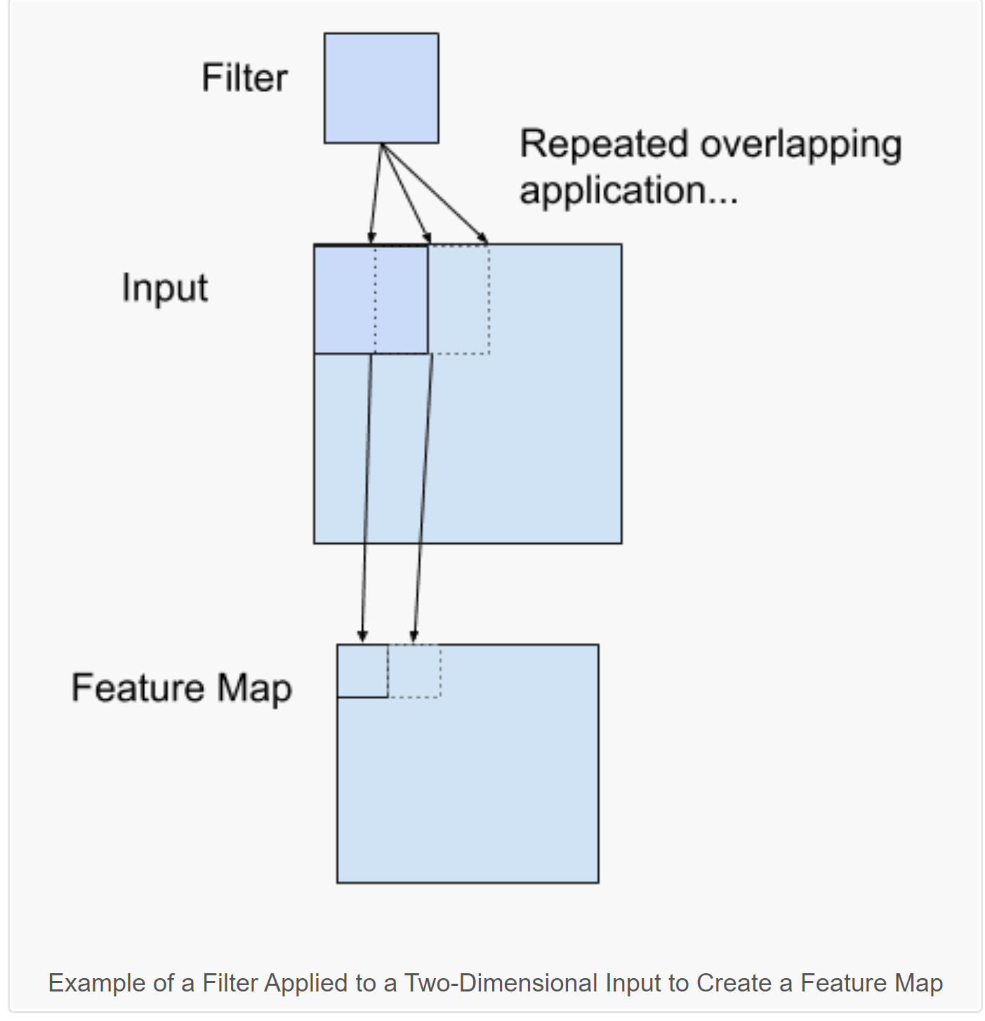
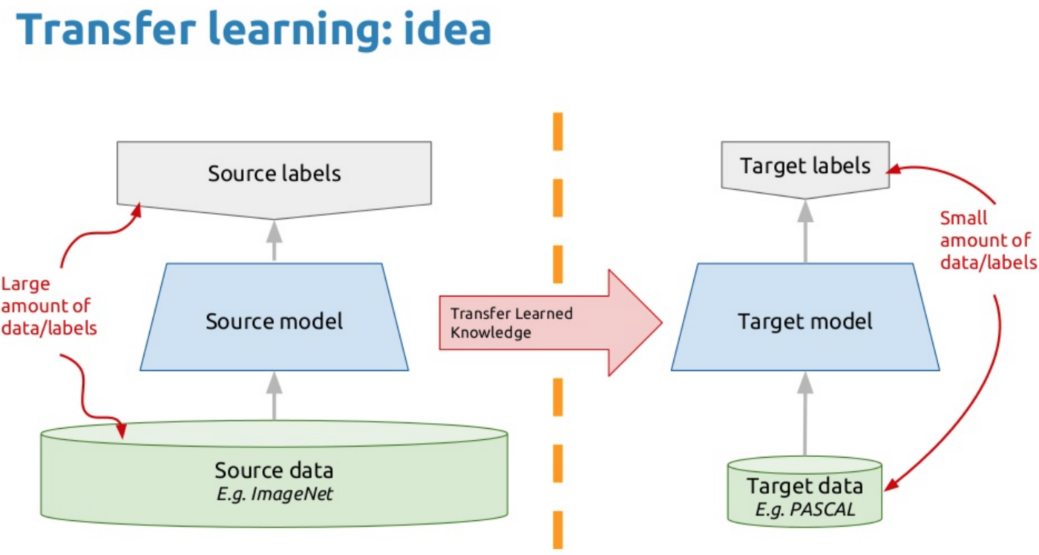
CNN FOR IMAGE CLASSIFICATION
CNN MODEL
Input, filters, feature maps
Activation, pooling, fully connected layers
TRANSFER
Transfer learning idea
Execution steps
Metrics, plots and model comparison.

Slide 5
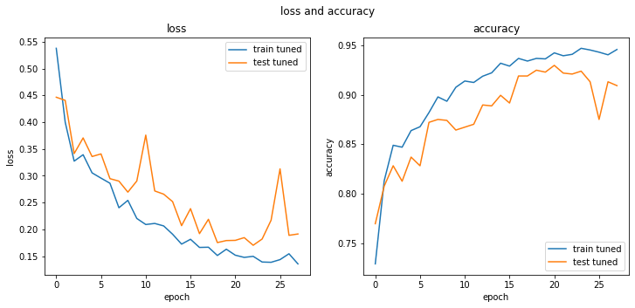
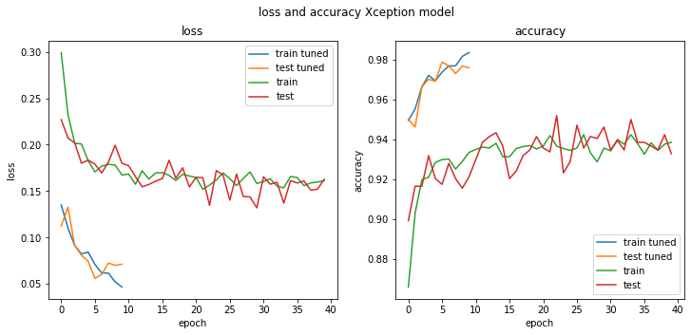
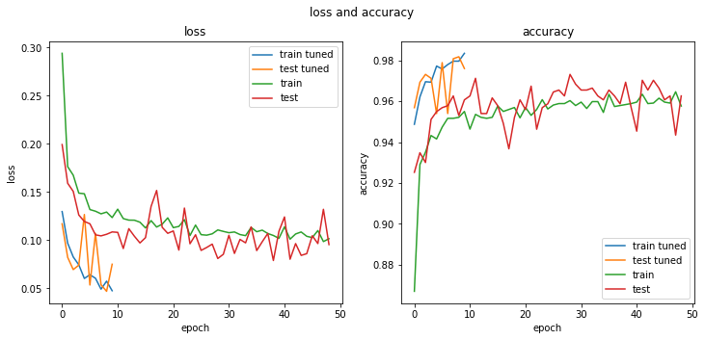
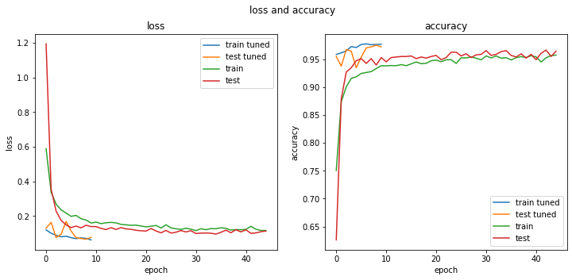
CNN MODELS
Base Model
Xception
Resnet50
VGG16

Slide 6
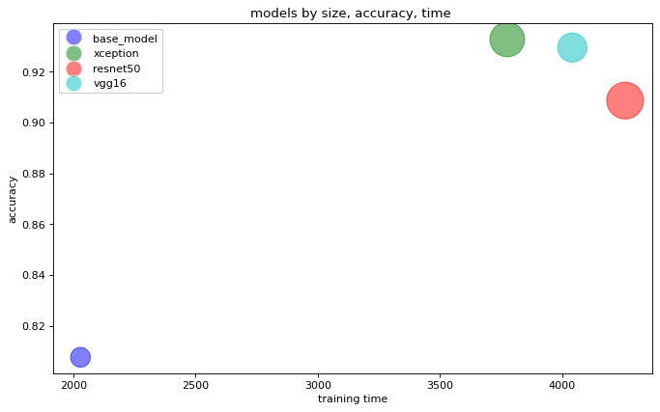
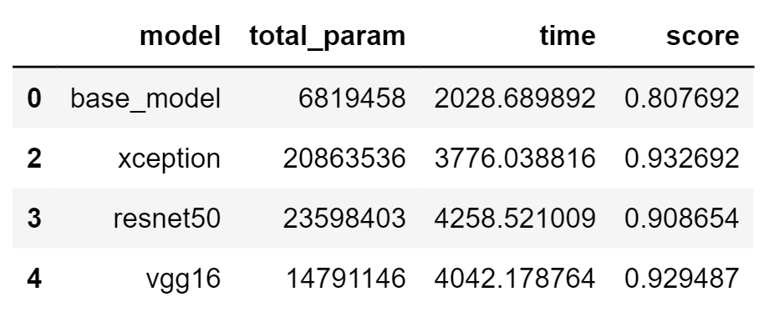
COMPARE MODELS
VGG16 is the best model
Highest accuracy score
Least training time among pretrained models
93% accuracy score, 95% recall and precision for positive class

Slide 7
CONCLUSION
VGG16 yield best scores compared to other models
The model was saved on HDD
The model weights can be loaded and used for X-ray prediction

Slide 8
QUESTIONS

